Slide 1
Telemetry Onboarding
Firefox Data Platform Team

Slide 2
Structure
Privacy & Policies
What is Telemetry?
Summary dashboards
Telemetry dashboards
Adding a probe
What is a ping?
Data Pipeline
Experiments
Offline Processing
Stats

Slide 3
Before we Begin
https://analysis.telemetry.mozilla.org/

Slide 4
Privacy Policy
No surprises: use and share information in a way that is transparent and benefits the user
User control: develop products and advocate for best practices that put users in control of their data and online experiences
Limited data: collect what we need, de-identify where we can and delete when no longer necessary
Sensible settings: design for a thoughtful balance of safety and user experience
Defense in depths: maintain multi-layered security controls and practices, many of which are publicly verifiable
https://www.mozilla.org/privacy/

Slide 5
Data Collection Policy
When proposing a new measurement or data system, consider the requirements and the necessary data properties, e.g:
Is it necessary to take a measurement from all users? Or is it sufficient to measure only prerelease users?
Is it desirable to track data changes over time? With what frequency? With what latency?
For every new measurement, even a trivial measurement, please request
approval by setting the feedback flag for the module owner or a peer.
Owner: Benjamin Smedberg
https://wiki.mozilla.org/Firefox/Data_Collection

Slide 6
Questions?

Slide 7
What is Telemetry?
Telemetry is a system that:
measures how Firefox behaves in the real world
collects non-personal information about performance, hardware, and other stuff,
allows us to identify bugs, issues, and regressions
allows us to conduct longitudinal studies and experiments

Slide 8
Data Sets
Base Telemetry (formerly FHR) contains critical, representative data that supports longitudinal studies
Enabled by default on all channels
Extended Telemetry send richer performance and usage data
Disabled by default on release
Enabled by default on prerelease

Slide 9
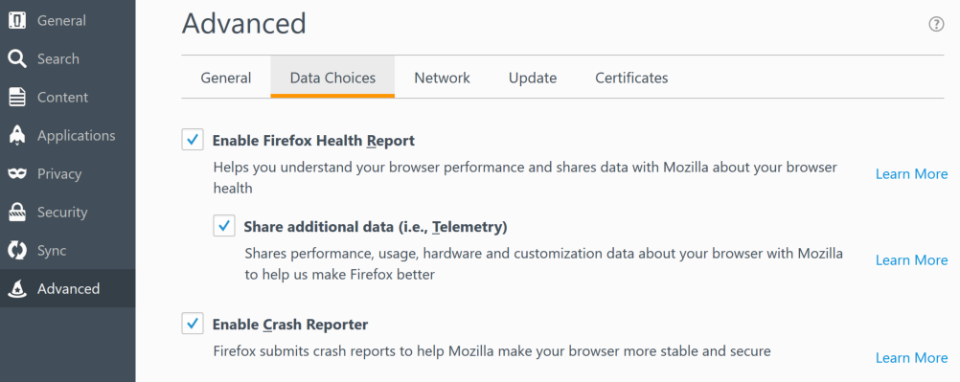
export MOZ_TELEMETRY_REPORTING=1
#export MOZILLA_OFFICIAL=1

Slide 10
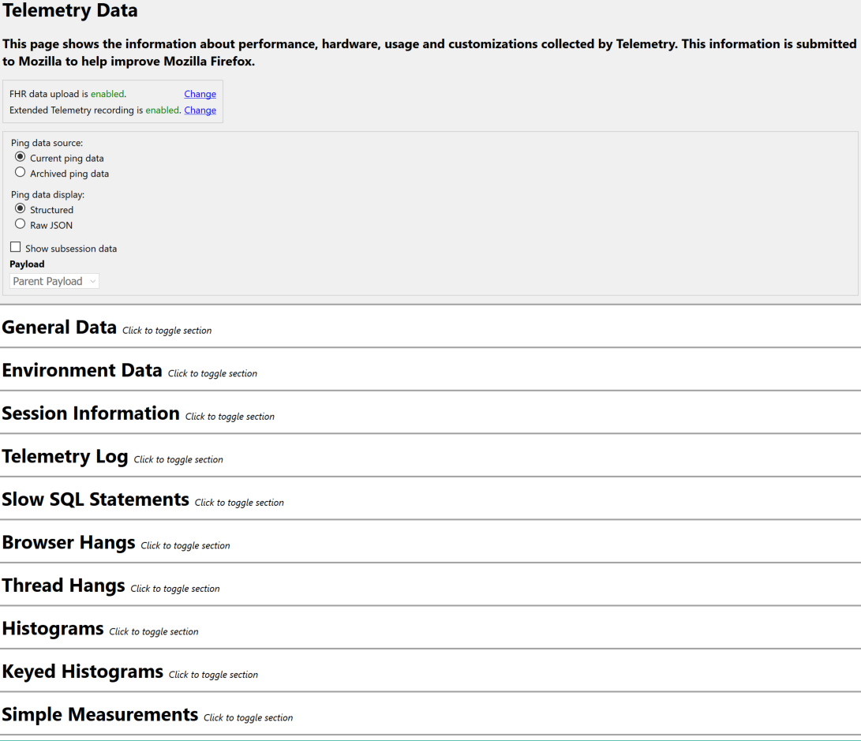
about:telemetry

Slide 11
References
https://wiki.mozilla.org/Telemetry
https://wiki.mozilla.org/Firefox_Health_Report

Slide 12
Questions?

Slide 13

Summary Dashboards
https://metrics.services.mozilla.com/

Slide 14
Questions?

Slide 15
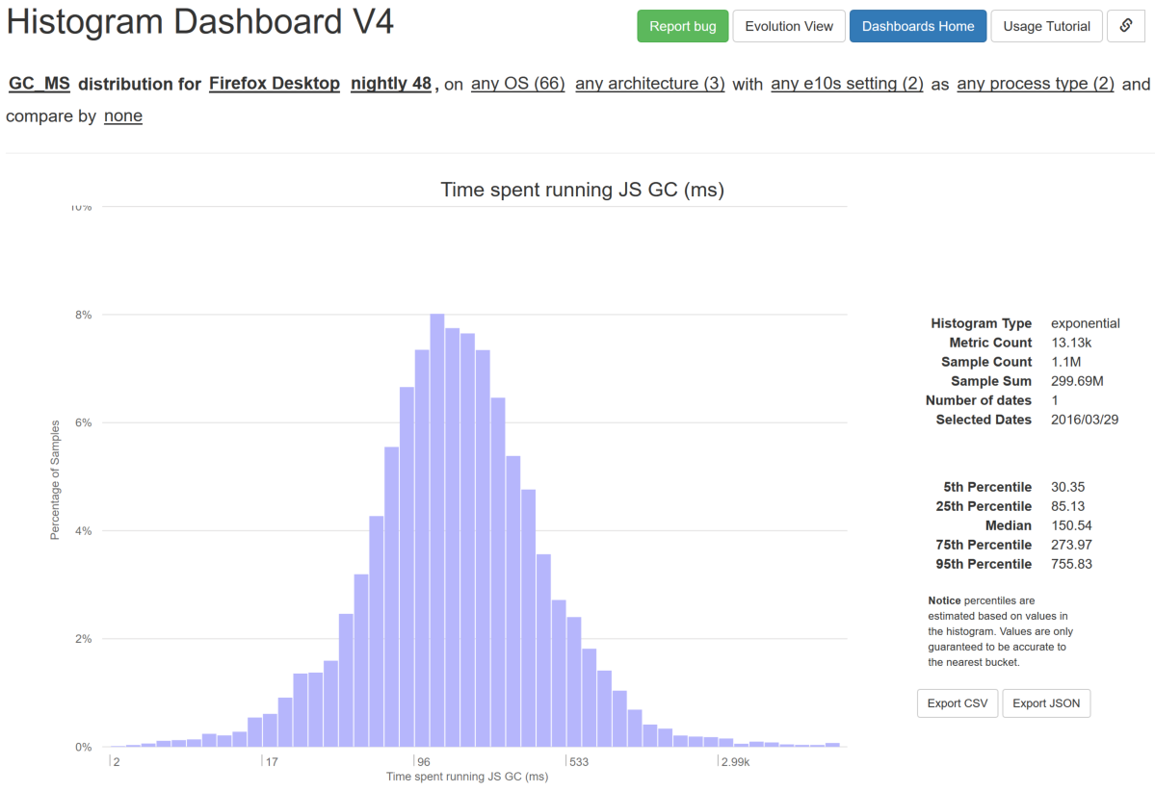
Telemetry Dashboards
https://telemetry.mozilla.org/

Slide 16
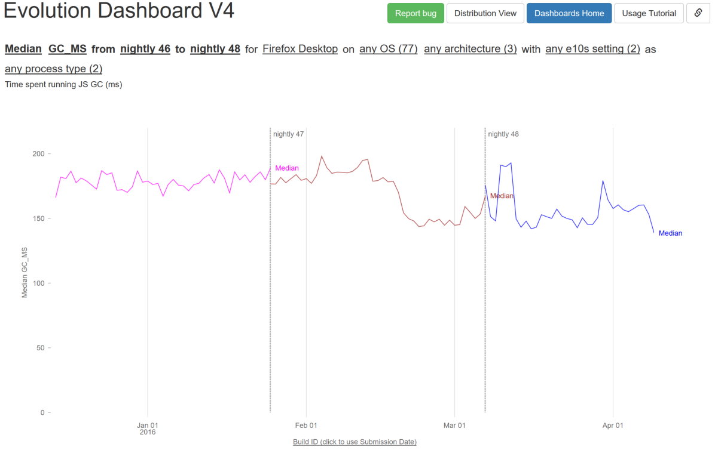
https://telemetry.mozilla.org/new-pipeline/evo.html

Slide 17
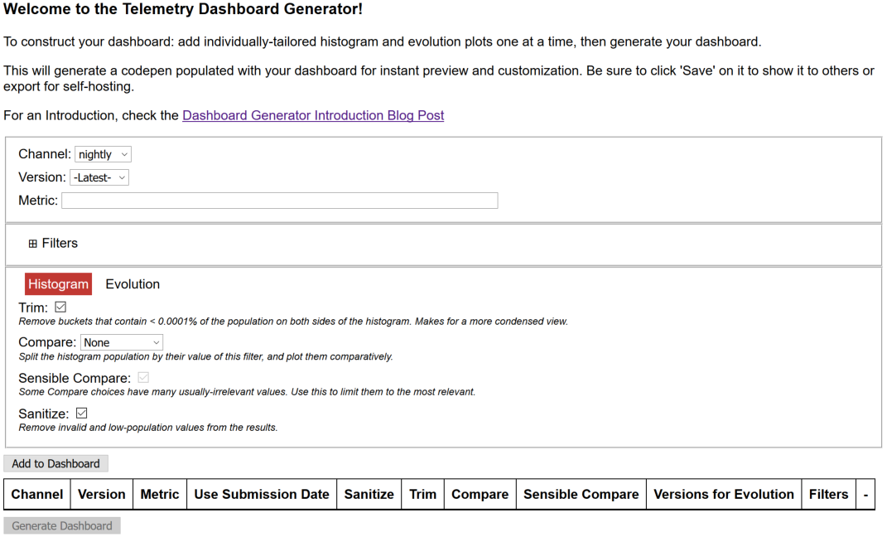
https://telemetry.mozilla.org/dashboard-generator/index.html

Slide 18

Aggregates by JS
telemetry.js v2:
https://github.com/mozilla/telemetry-dashboard/blob/master/v2/doc.md
telemetry-wrapper.js:
https://github.com/mozilla/telemetry-dashboard/tree/gh-pages/wrapper

Slide 19
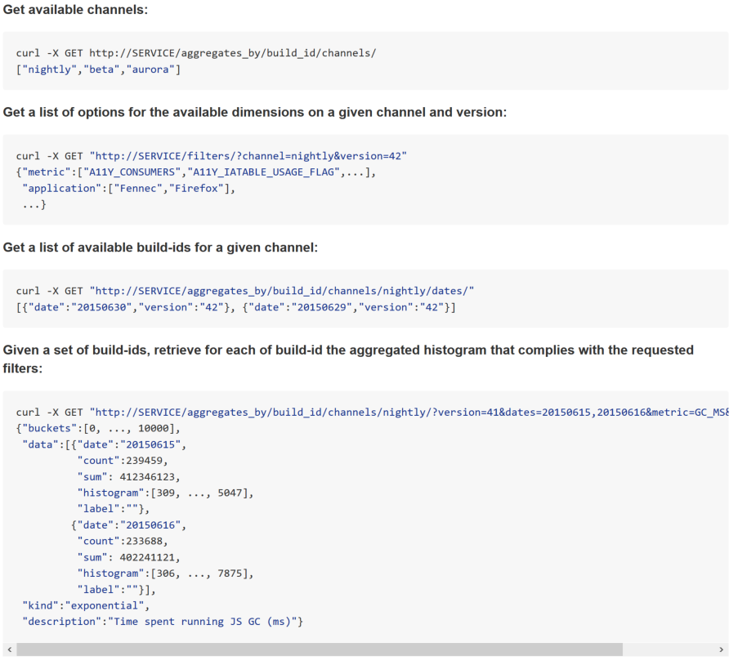
Aggregates by HTTPS
https://github.com/vitillo/python_mozaggregator/blob/master/README.md

Slide 20
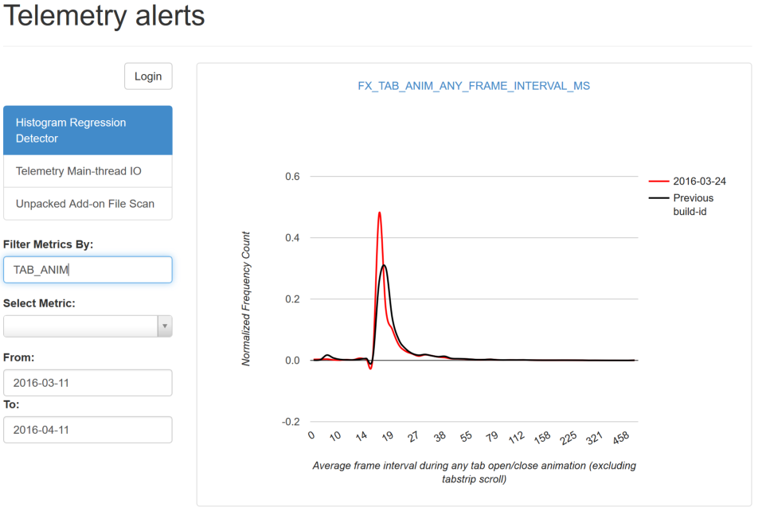
https://alerts.telemetry.mozilla.org/

Slide 21
References
http://robertovitillo.com/2015/07/02/telemetry-metrics-roll-ups/
https://anthony-zhang.me/blog/telemetry-demystified/
http://robertovitillo.com/2014/07/28/regression-detection-for-telemetry-histograms/
https://telemetry.mozilla.org/
https://metrics.services.mozilla.com/
https://chuttenblog.wordpress.com/tag/telemetry/

Slide 22
Questions?

Slide 23
Adding a Histogram
Telemetry histograms are the preferred way to track numeric measurements. There are six types:
flag, e.g. FXA_CONFIGURED
boolean, e.g. E10S_WINDOW
count, e.g. CONTENT_DOCUMENTS_DESTROYED
enumerated, e.g. DEVICE_RESET_REASON
linear, e.g. GC_MAX_PAUSE_MS
exponential, e.g. GC_MARK_MS
https://developer.mozilla.org/docs/Mozilla/Performance/Adding_a_new_Telemetry_probe

Slide 24
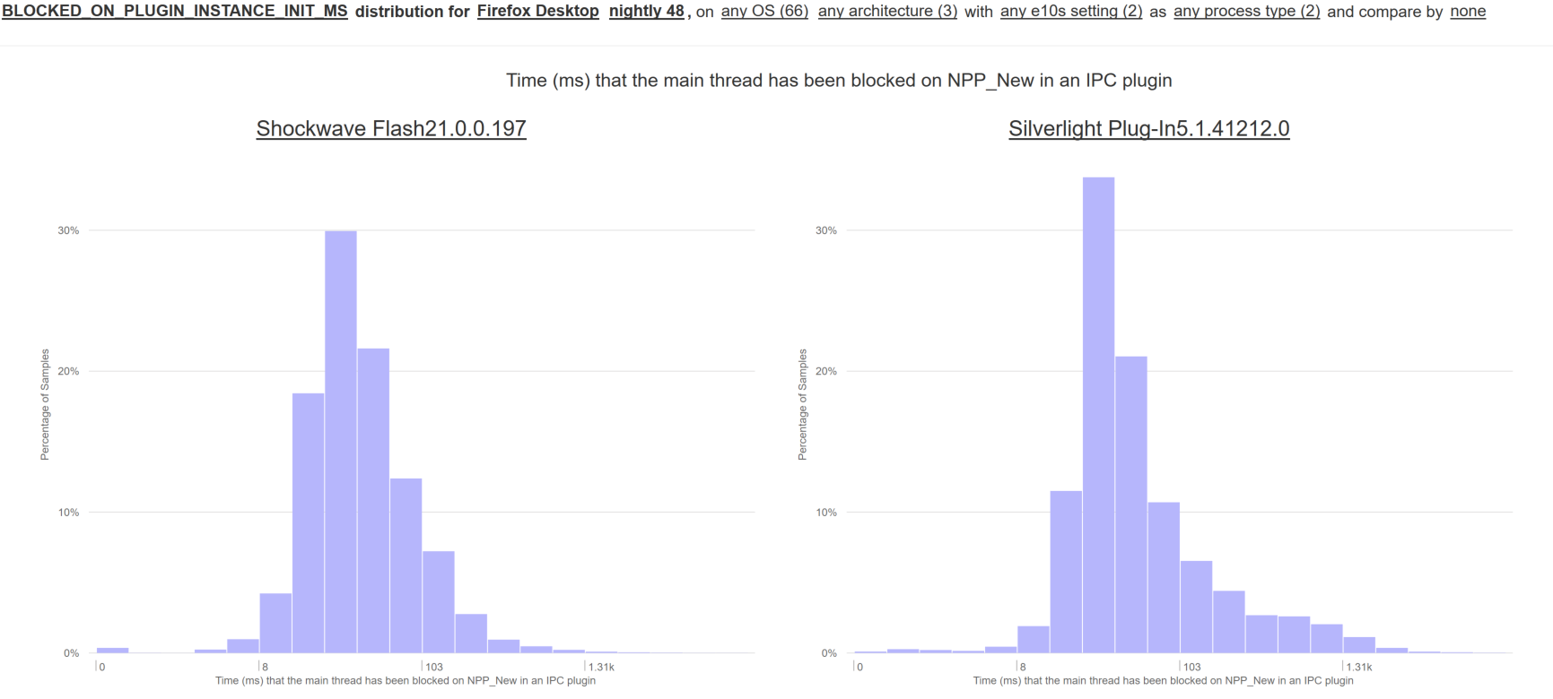
Keyed Histograms

Slide 25
Declaring a Histogram
toolkit/components/telemetry/Histograms.json
"TELEMETRY_TUTORIAL_PROBE": {
"alert_emails": ["rvitillo@mozilla.com"],
"bug_numbers": [1242013],
"expires_in_version": "55",
"kind": "exponential",
"high": 1000,
"n_buckets": 50,
"description": "Telemetry tutorial probe (ms)"
},
./mach build toolkit/components/telemetry
./mach run

Slide 26
Accumulating Data
Go to about:telemetry and bring up a console with Ctrl+Shift+K
Telemetry.isOfficialTelemetry
<- false
h = Services.telemetry.getHistogramById("TELEMETRY_TUTORIAL_PROBE")
<- JSHistogram { , 4 more… }
h.add(42)
<- function add()

Slide 27
References
https://developer.mozilla.org/en-US/docs/Mozilla/Performance/Adding_a_new_Telemetry_probe

Slide 28
Questions?

Slide 29
What is a Ping?
A Telemetry ping is the data that we send to Telemetry servers.
On the client it is stored as JSON
Pings follow a common data format. Different types of pings have different types of data payloads.
https://gecko.readthedocs.org/latest/toolkit/components/telemetry/telemetry/

Slide 30
Ping Types
“main”: contains most of the measurements that track the performance and health of Firefox instances in the wild. Its “reason” field documents what triggered the ping (e.g. shutdown)
“crash”: captured after the parent Firefox process crashes
others: there are others of more specific utility, and you can also define and submit custom ones if you’d like.
http://gecko.readthedocs.org/latest/toolkit/components/telemetry/telemetry/pings.html#ping-types

Slide 31
Common Ping Format
{ type: <string>, // "main", "activation", "deletion", "saved-session", ... id: <UUID>, // a UUID that identifies this ping creationDate: <ISO date>, // the date the ping was generated version: <number>, // the version of the ping format, currently 4 application: { architecture: <string>, // build architecture, e.g. x86 buildId: <string>, // "20141126041045" name: <string>, // "Firefox" version: <string>, // "35.0" displayVersion: <string>, // "35.0b3" vendor: <string>, // "Mozilla" platformVersion: <string>, // "35.0" xpcomAbi: <string>, // e.g. "x86-msvc" channel: <string>, // "beta" }, clientId: <UUID>, // optional environment: { ... }, // optional, not all pings contain the environment payload: { ... }, // the actual payload data for this ping type }
http://gecko.readthedocs.org/latest/toolkit/components/telemetry/telemetry/common-ping.html

Slide 32
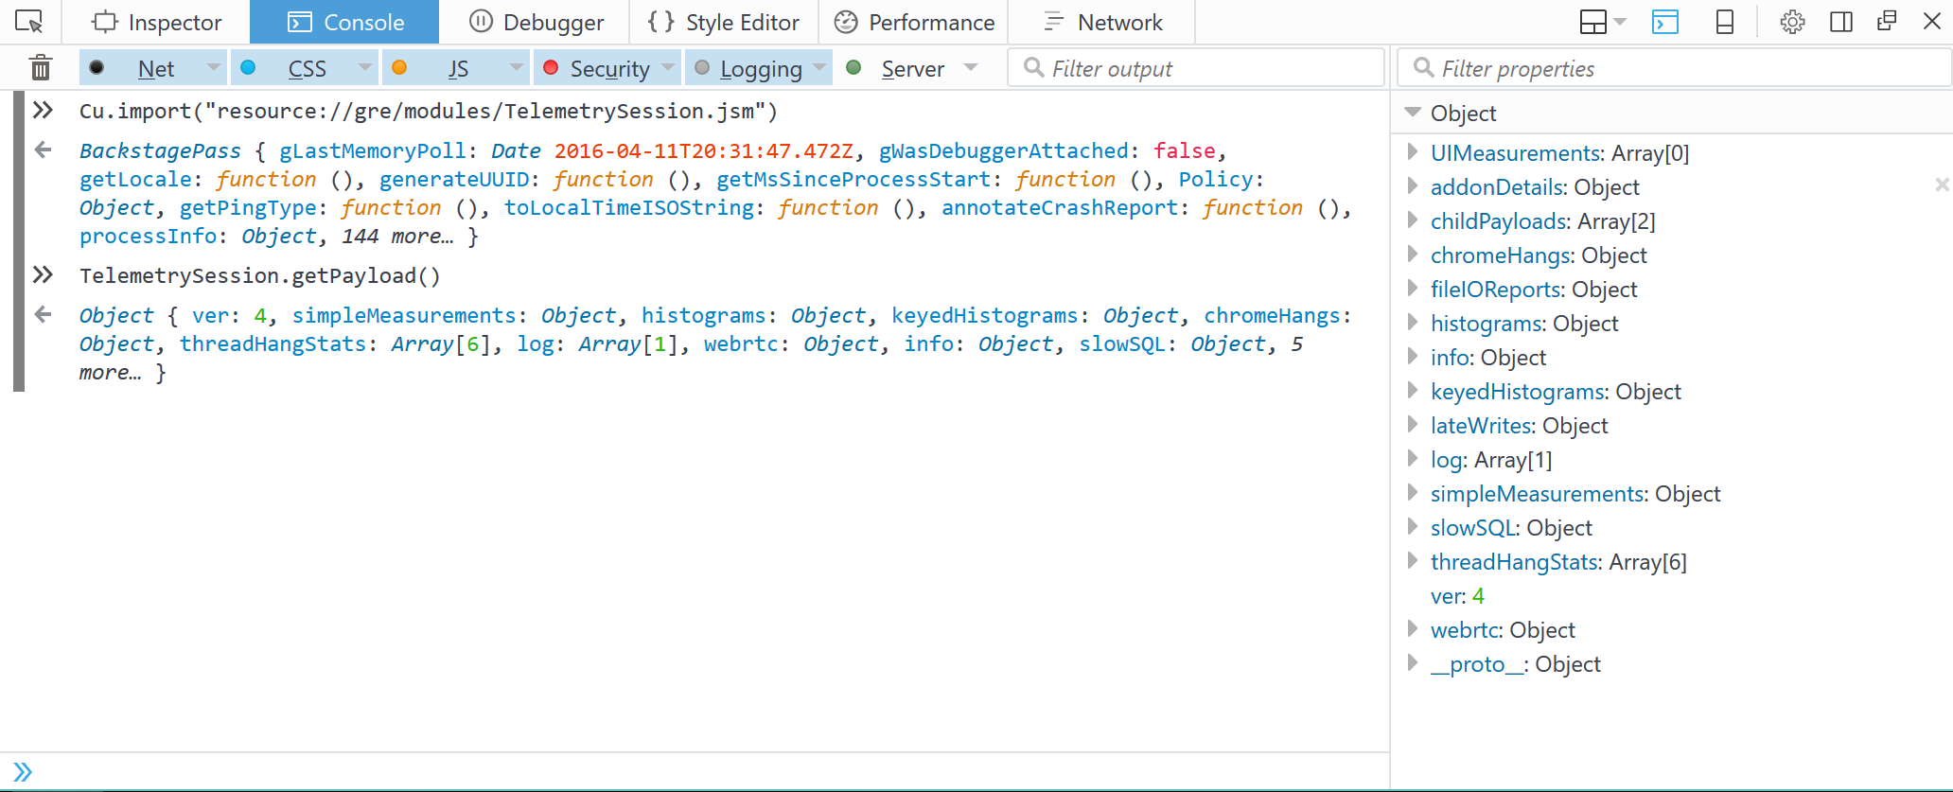
Main Ping Payload
Cu.import("resource://gre/modules/TelemetrySession.jsm")

Slide 33
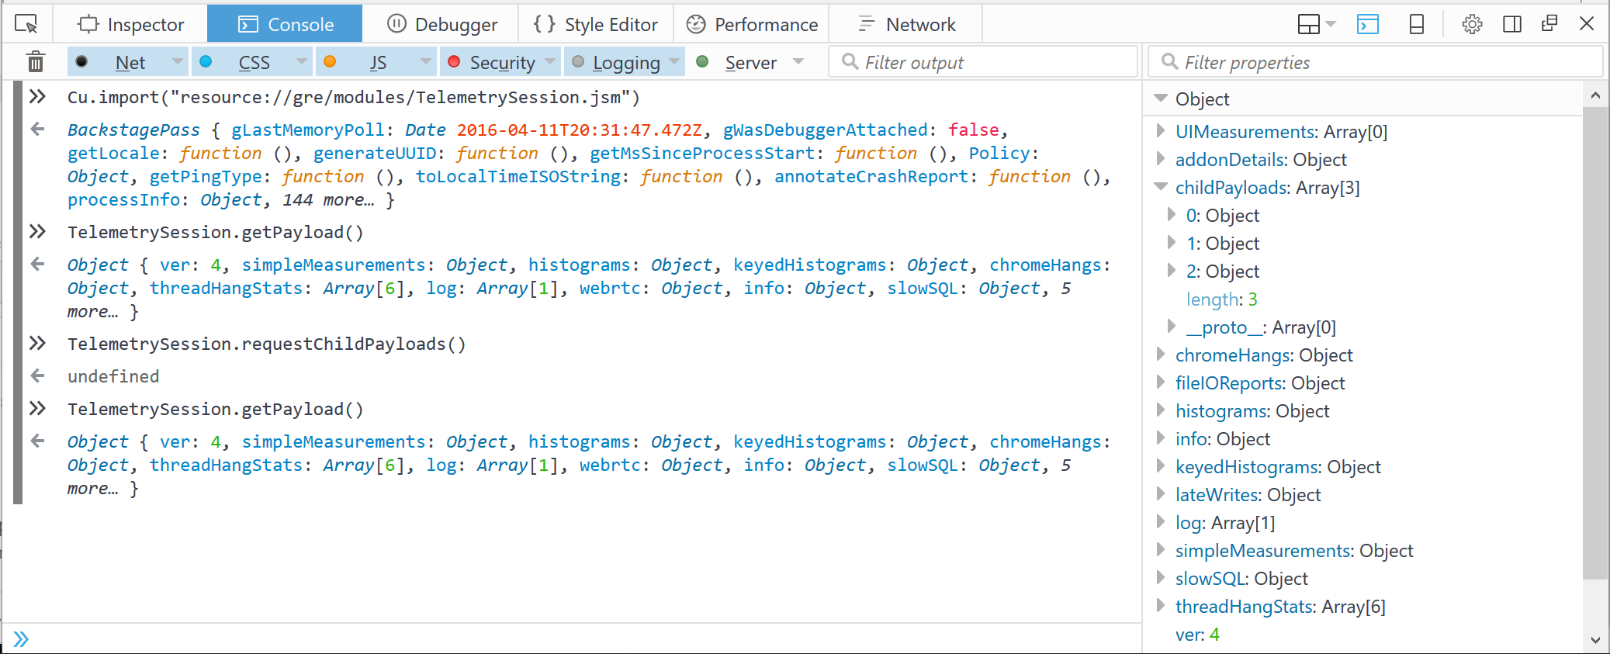
E10s Caveat

Slide 34
Environment
Data that is expected to be characteristic of performance and other behaviour.
Not expected to change too often.
Changes to many of these fields is detected and leads to a session split in the “main” ping.
http://gecko.readthedocs.org/latest/toolkit/components/telemetry/telemetry/environment.html

Slide 35
References
http://gecko.readthedocs.org/latest/toolkit/components/telemetry/telemetry/index.html

Slide 36
Questions?

Slide 37

Break
Time

Slide 38
Data Pipeline
How we ingest, transform, store and analyse incoming data
The endpoint is an HTTP server that
listens for POST/PUT from Firefox
does some decoding/preprocessing
sends data off for streaming analyses (Heka)
archives data to S3 for offline analyses (Spark)
https://wiki.mozilla.org/CloudServices/DataPipeline

Slide 39
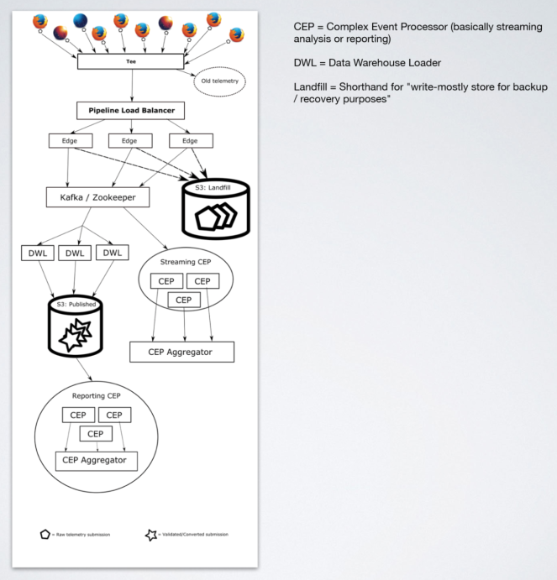

Slide 40
References
https://wiki.mozilla.org/CloudServices/DataPipeline
https://github.com/mozilla-services/data-pipeline
https://github.com/mozilla-services/heka
https://github.com/apache/spark/

Slide 41
Questions?

Slide 42
Offline Processing
IPython, Pandas, and Spark
https://github.com/vitillo/telemetry-onboarding/tree/master/notebooks

Slide 43
Offline Processing
Using SQL
https://sql.telemetry.mozilla.org/

Slide 44
Questions?

Slide 45
Experiments
Targeted, restartless addons
Currently only available on desktop Firefox
Must undergo Data Collection Review; may require privacy/security reviews as well
Product approval required
https://wiki.mozilla.org/Telemetry/Experiments

Slide 46
Flags for Testing
experiments.force-sample-value = "0.0"
experiments.logging.level = 0
experiments.manifest.cert.checkAttributes = false
experiments.manifest.uri = "http://localhost:8000/firefox-manifest.json
xpinstall.signatures.required = false

Slide 47
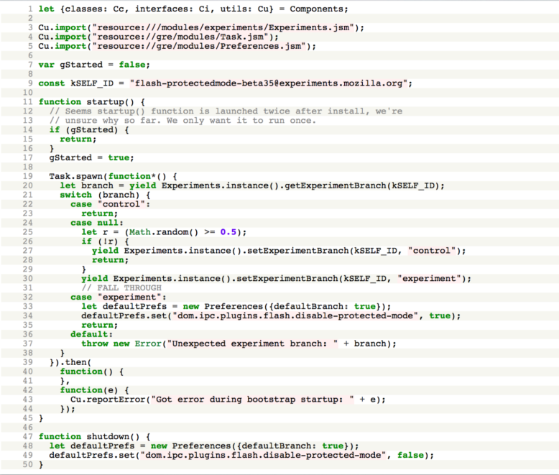
https://bugzilla.mozilla.org/show_bug.cgi?id=1110215

Slide 48
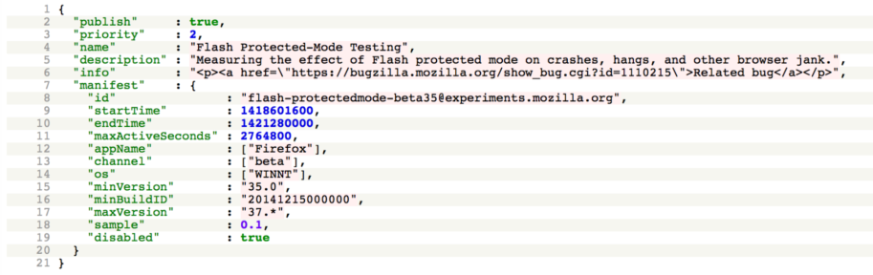
http://hg.mozilla.org/webtools/telemetry-experiment-server/file/tip/experiments/flash-protectedmode-beta/manifest.json

Slide 49
Bug 1111791
“Telemetry report: effect of the Flash protected-mode experiment”
https://bugzilla.mozilla.org/show_bug.cgi?id=1111791

Slide 50
References
https://wiki.mozilla.org/Telemetry/Experiments
https://developer.mozilla.org/en-US/Add-ons/Bootstrapped_extensions
https://wiki.mozilla.org/QA/Telemetry#Telemetry_Experiments.2FFHR_Documentation
http://codefirefox.com/video/install-telmetry-experiment
http://hg.mozilla.org/webtools/telemetry-experiment-server/file/tip/experiments
https://bugzilla.mozilla.org/show_bug.cgi?id=1110215
https://bugzilla.mozilla.org/show_bug.cgi?id=1111791

Slide 51
Questions?

Slide 52

Stats

Slide 53

Use Representative Samples

Slide 54
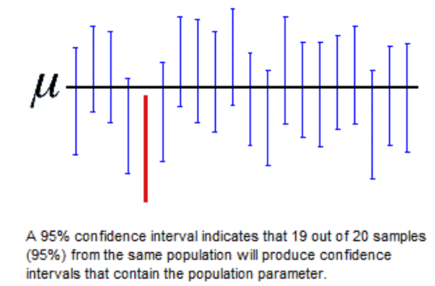
Use Sufficient Data
https://robertovitillo.com/2015/03/15/confidence-intervals-and-hypothesis-tests-for-engineers/

Slide 55
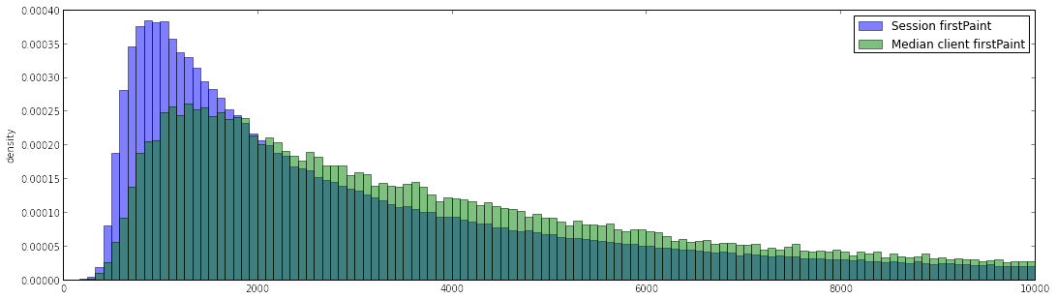
Beware of Pseudoreplication
http://robertovitillo.com/2014/12/19/clientid-in-telemetry-submissions/

Slide 56

Correlation is not Causation

Slide 57
Use the Correct Average
Arithmetic Mean: add up N values, divide by N
Median: sort the values and pick the middle one

Slide 58
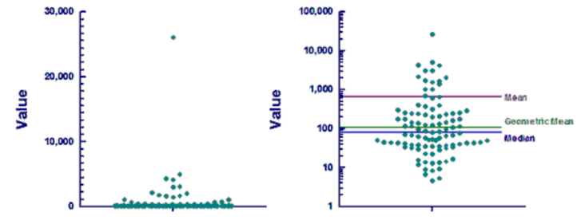
Use the Correct Average
Geometric Mean: take the Nth root of the product of the N values

Slide 59
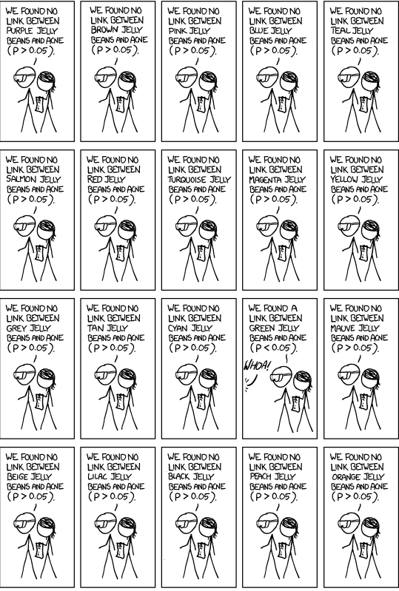

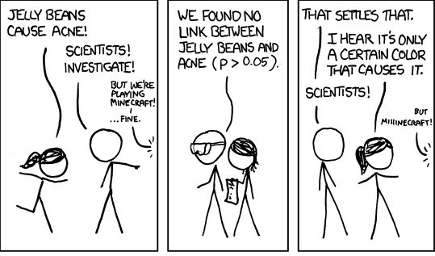
Control the False Discovery Rate

Slide 60
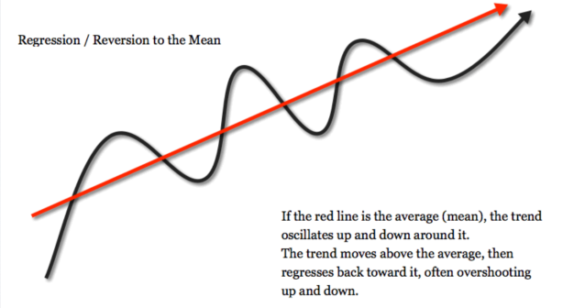
Regression Towards the Mean

Slide 61
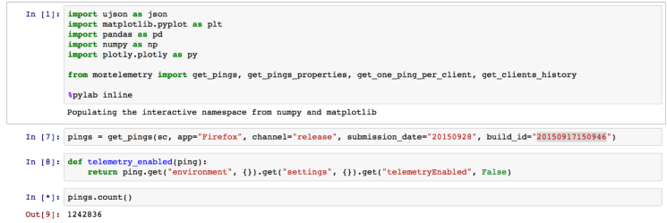
Reproducible Analyses

Slide 62
References
http://www.statisticsdonewrong.com/data-analysis.html
http://www.amazon.com/How-Lie-Statistics-Darrell-Huff/dp/0393310728
http://www.slideshare.net/RobertoAgostinoVitil/all-you-need-to-know-about-statistics

Slide 63
Questions?

Slide 64
Contact
Don’t get frustrated, get help.
IRC: #telemetry #datapipeline
Teams: Measurement, Metrics, Data Engineering
FHR-dev: https://mail.mozilla.org/listinfo/fhr-dev
FX-Data-Platform: https://groups.google.com/a/mozilla.com/forum/#!forum/fx-data-platform

Slide 65

Fin

